Slide 1

The principles of
animation
Tutor : Liyan Chen
Email: chenliyan@xmu.edu.cn

Slide 2
Chapter 9
An animation process

Slide 3

A complete An animation works, to have strict planning and operating procedures, mainly divided into topics, data collection, design script draft and sub-lens and other steps.

Slide 4

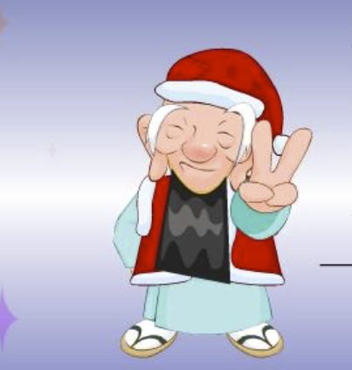
1. script

Slide 5
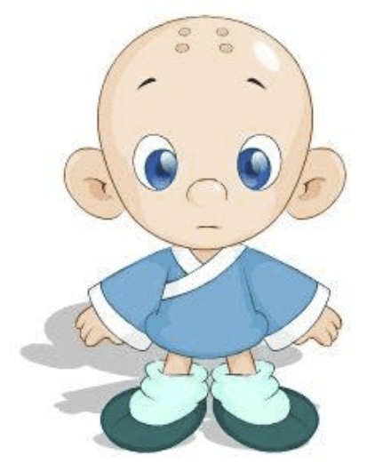
2. Character
design

Slide 6
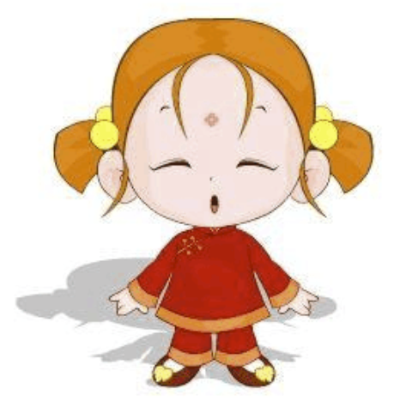

Slide 7
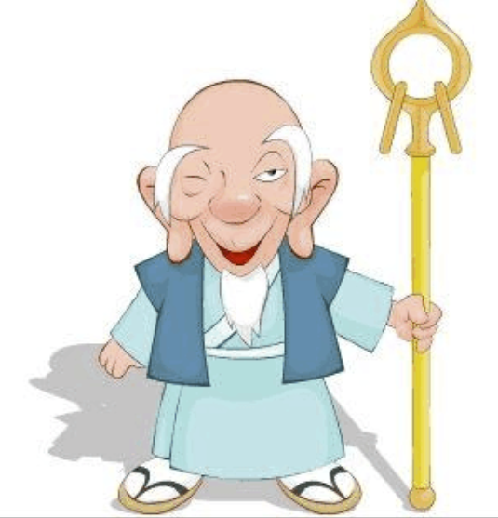

Slide 8
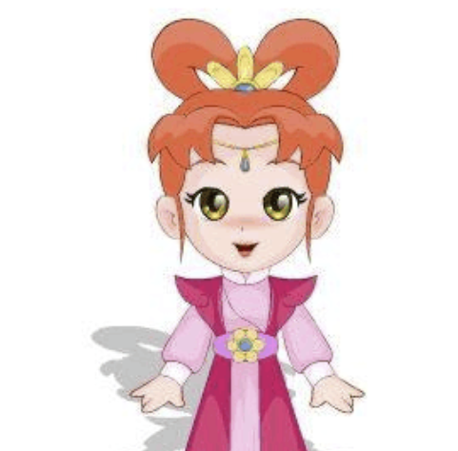

Slide 9


Slide 10
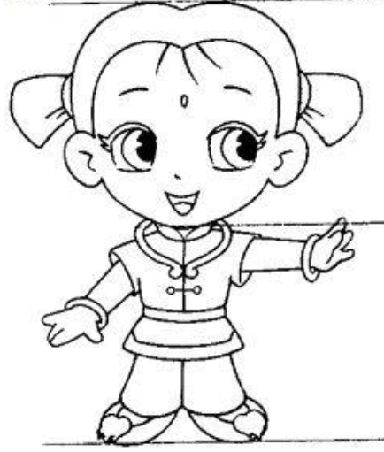
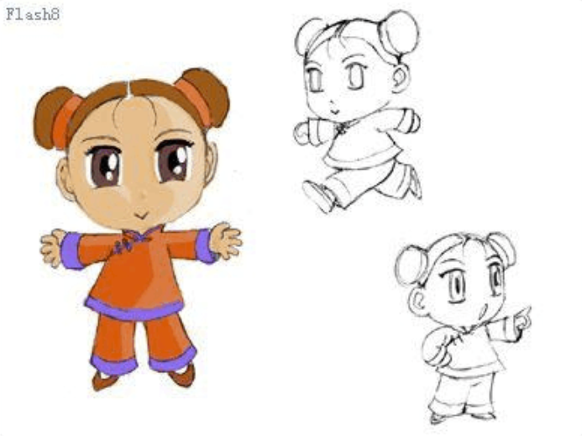

Slide 11
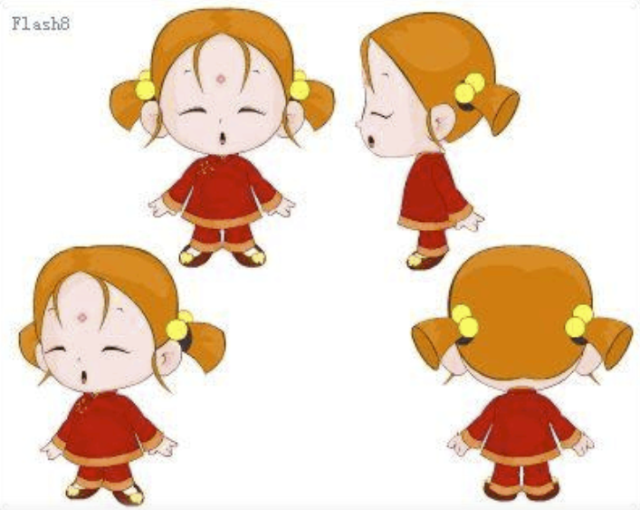

Slide 12
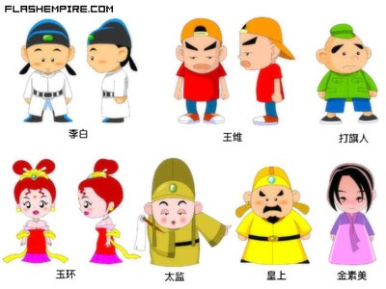

Slide 13
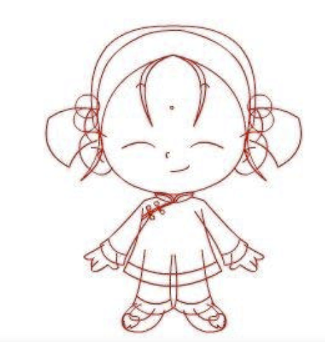

Slide 14
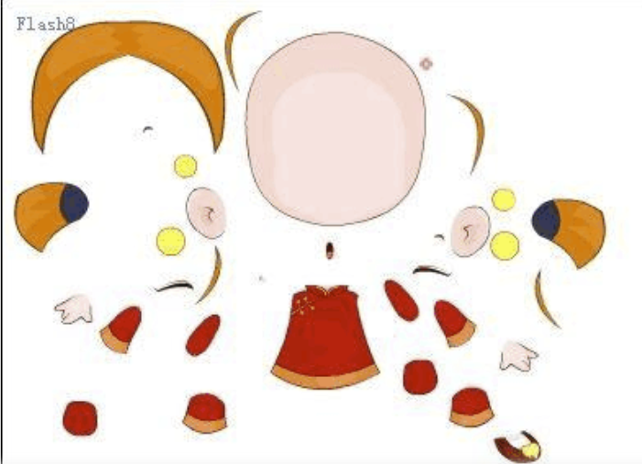

Slide 15
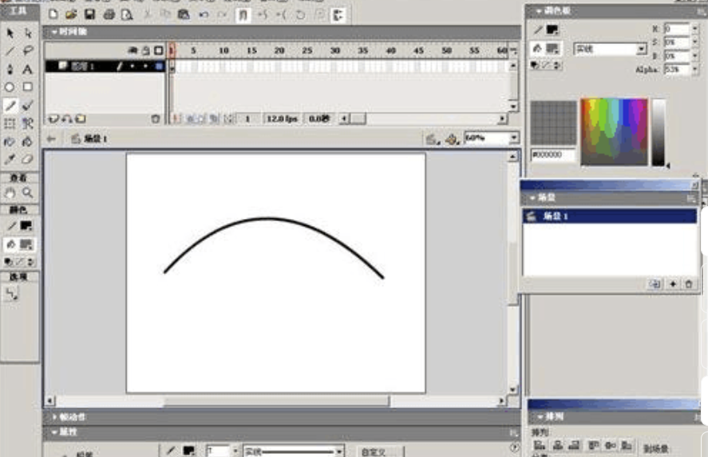
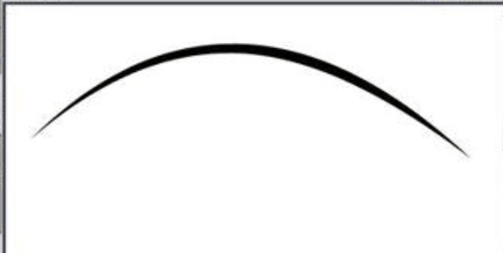

Slide 16
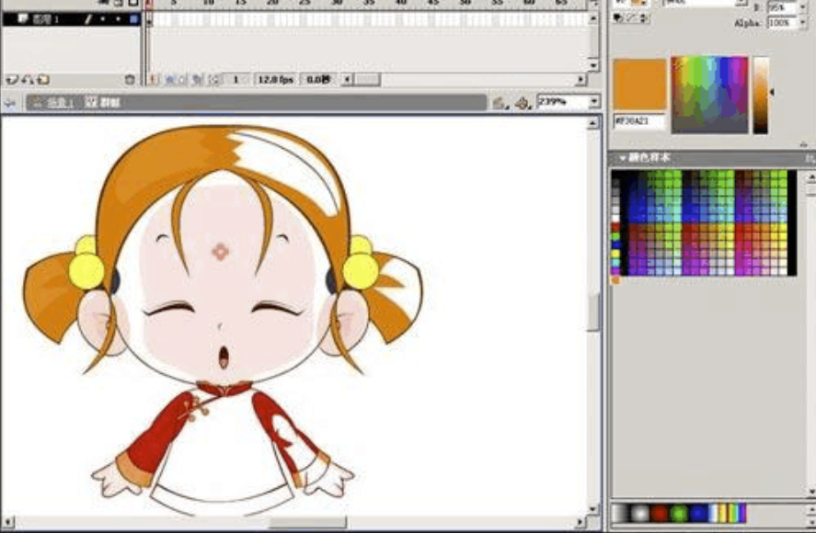
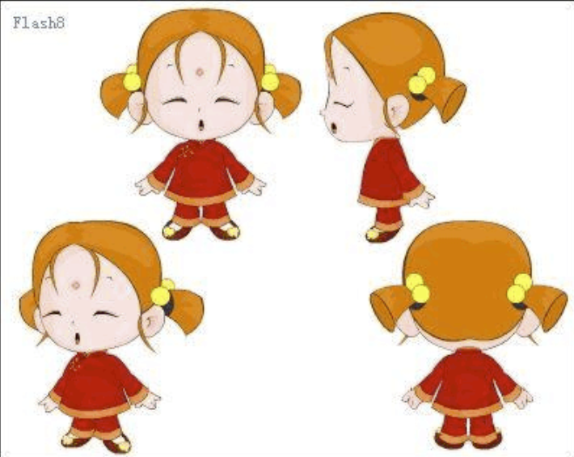

Slide 17
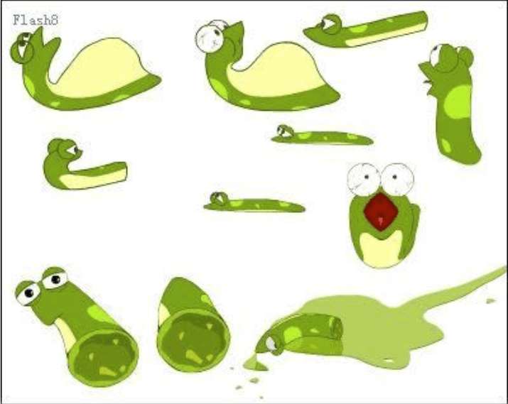

Slide 18
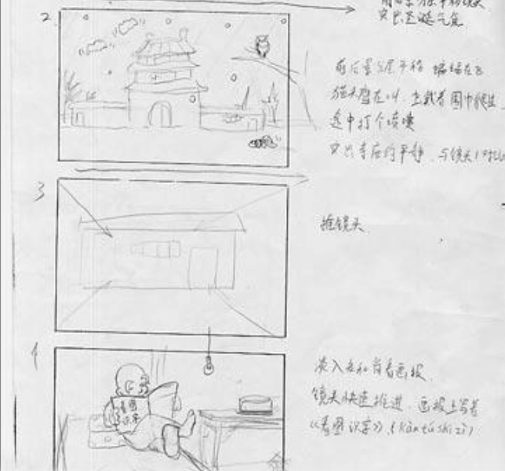
3. Storyboard design

Slide 19
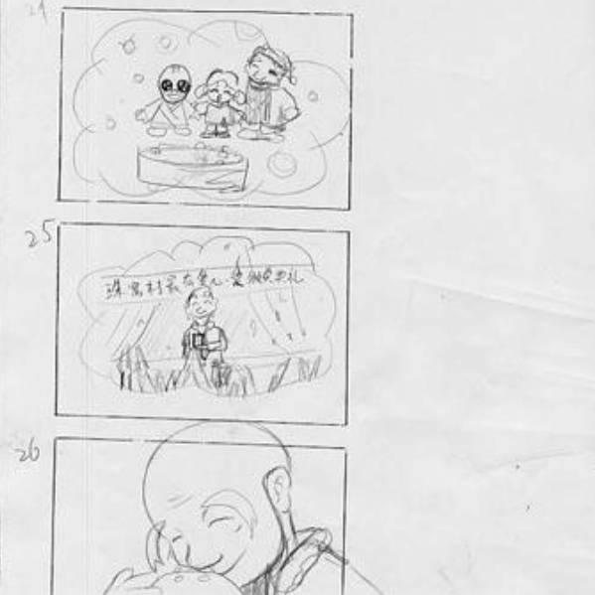

Slide 20
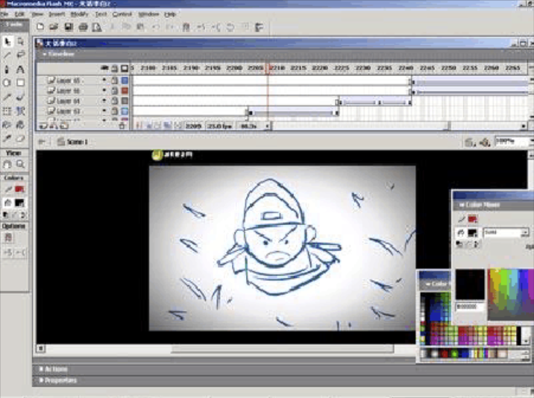

Slide 21
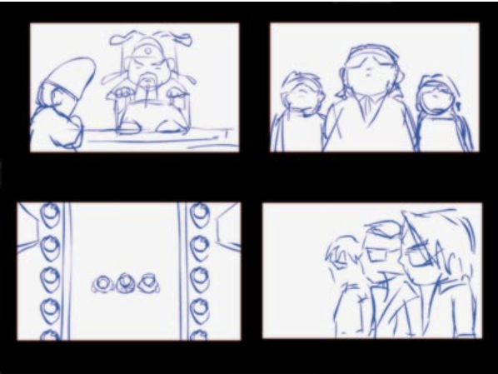

Slide 22
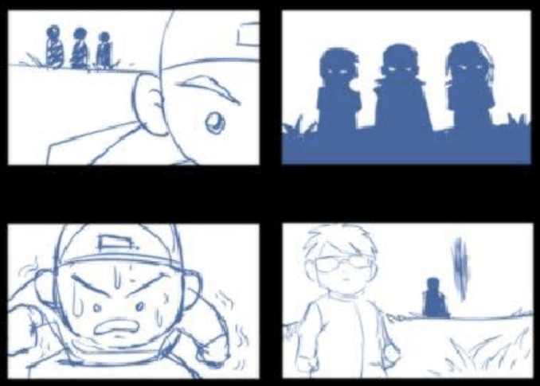

Slide 23
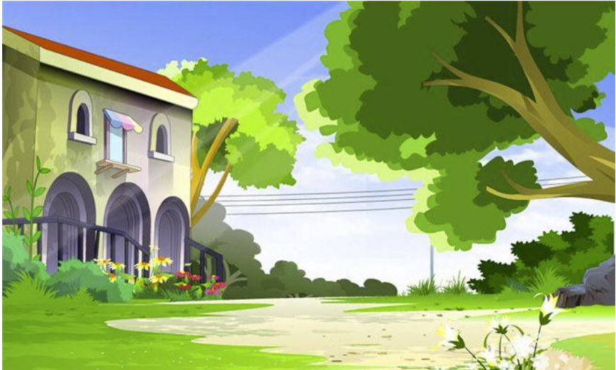
4. Scene
design

Slide 24
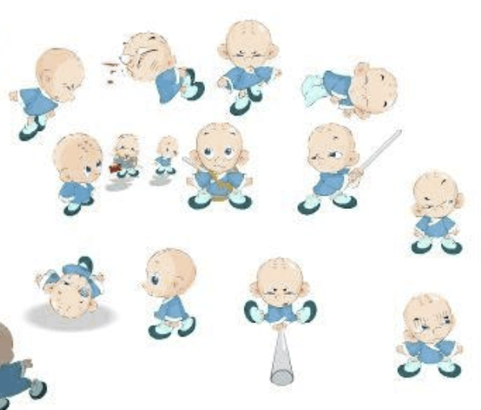
5. Animation

Slide 25
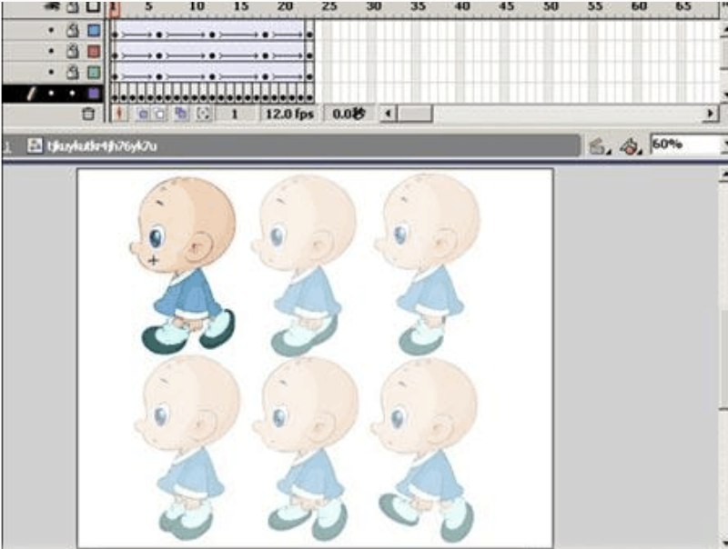

Slide 26
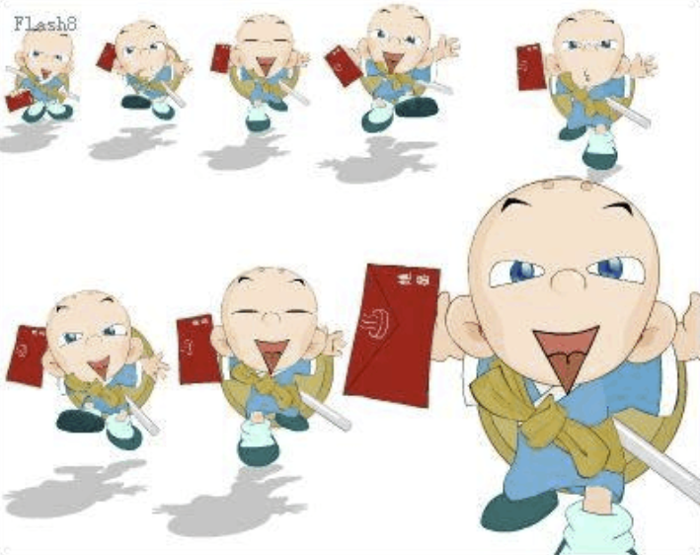

Slide 27
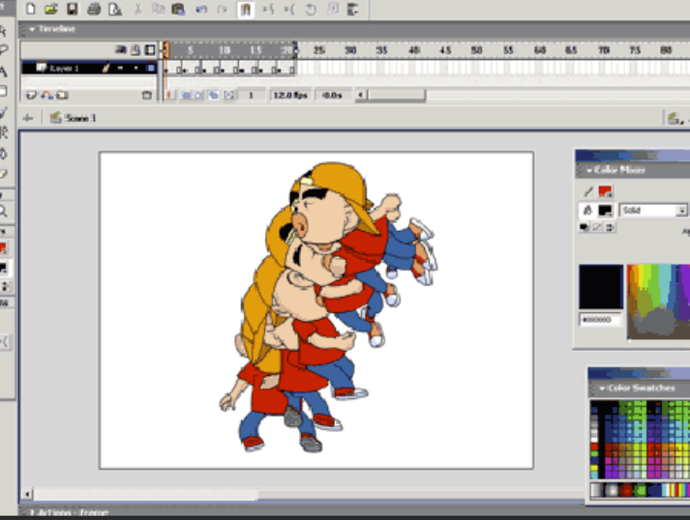

Slide 28
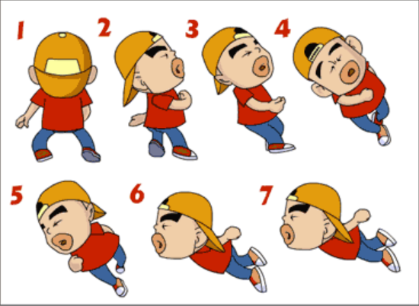

Slide 29
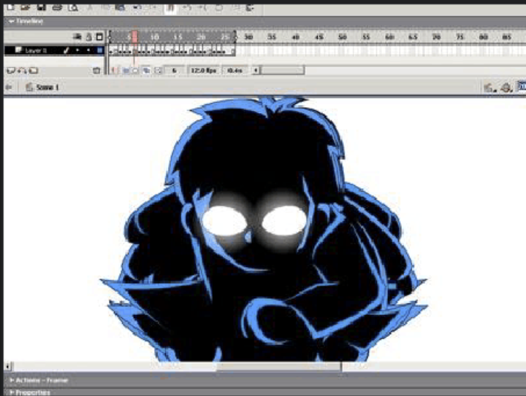

Slide 30
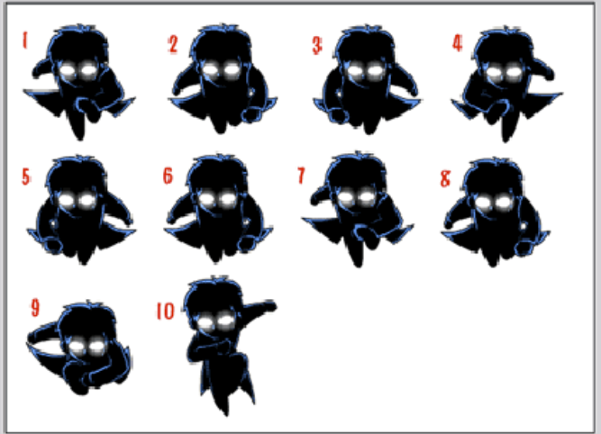

Slide 31
Techniques of time control in animation production
1. Time and frames: Movies and TV show at 24 frames per second.
2. Animation frames distance performance: Static start speed slow, fast motion, motion stop speed slow.
3. Cycle time: there are often cycles in animation, but the number of frames required varies from case to case. For example, a fast flying flag requires a 12 frame loop; a sprint requires 4 frames, a sprint requires 16 frames, and a jog requires 24 frames.

Slide 32
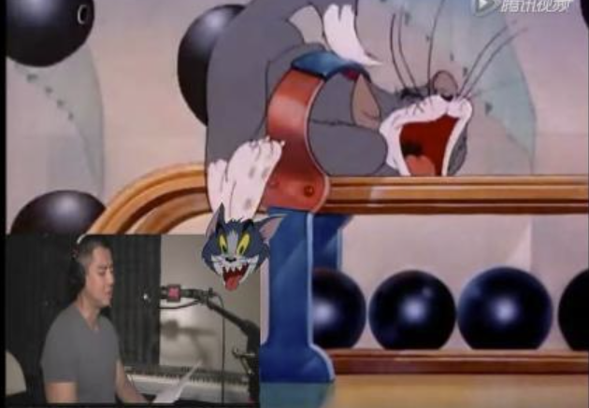

5. Dubbing

Slide 33
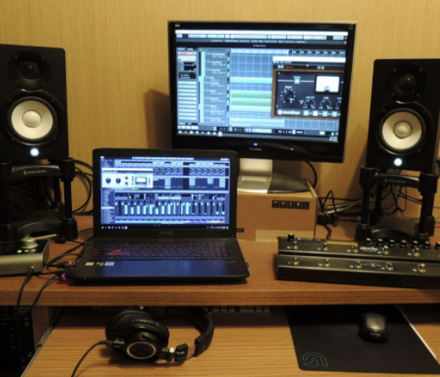

6. Music

Slide 34
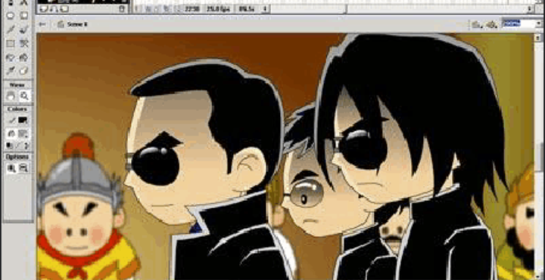
7. Synthesizes

Slide 35
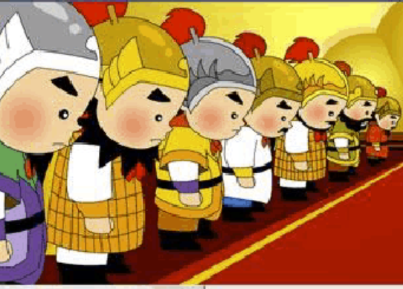

Slide 36
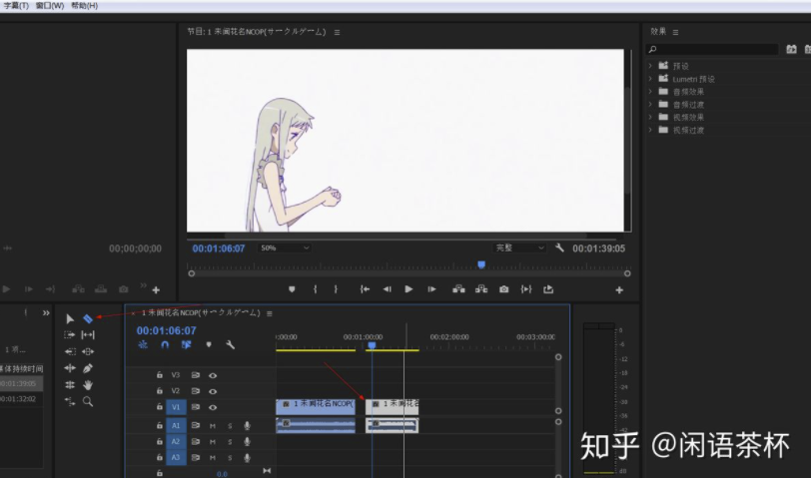
8. Editing

